Slide 1
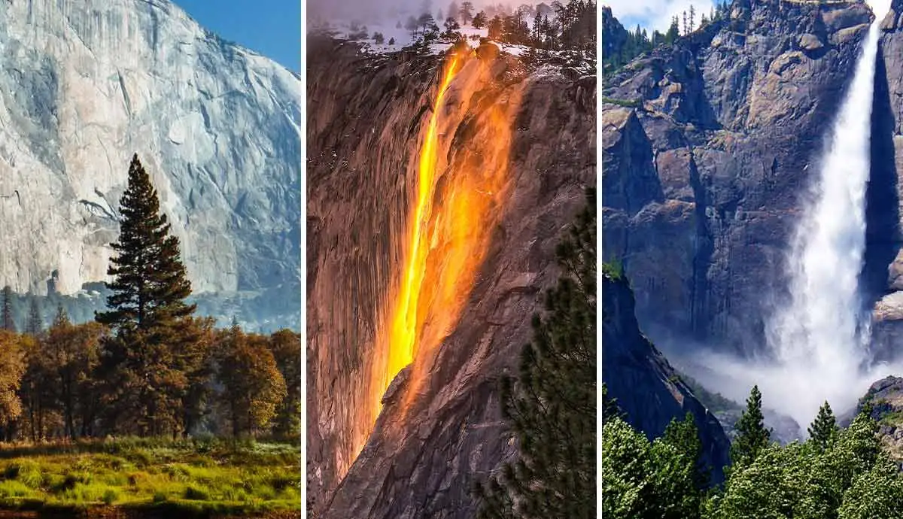
National Park Service:
America’s great outdoors
Andrew Matsuura and Ashley Nguyen

Slide 2
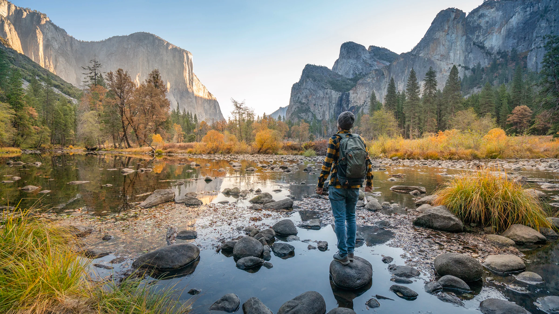
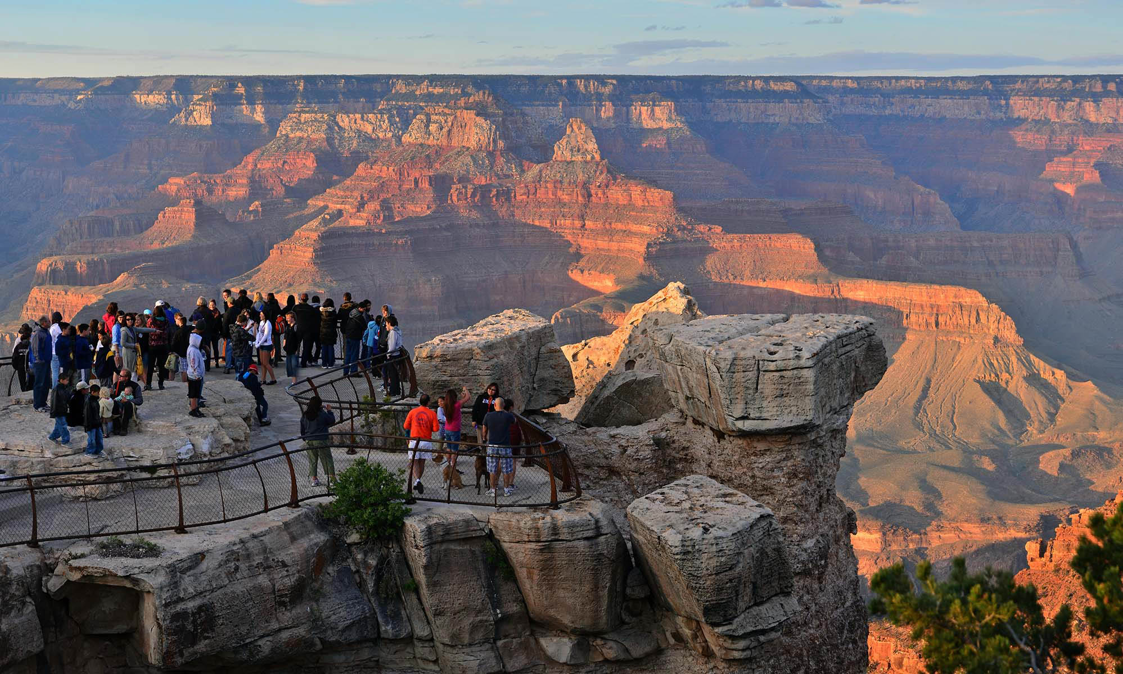
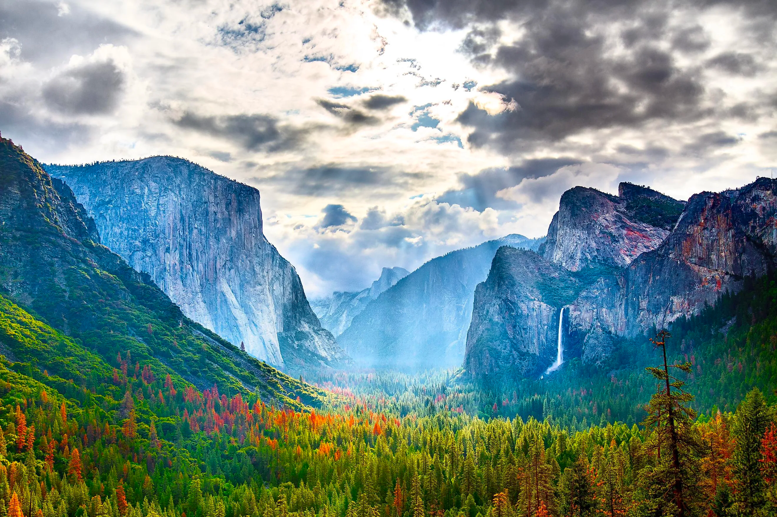
Questions
Has visitation increased during the COVID-19 Pandemic?
What is the best season to visit a park?
What is the best national park based on your location?
Are national parks the most popular parks to visit?
What are some of the most popular national parks?
How much is spent annually at a national park?

Slide 3
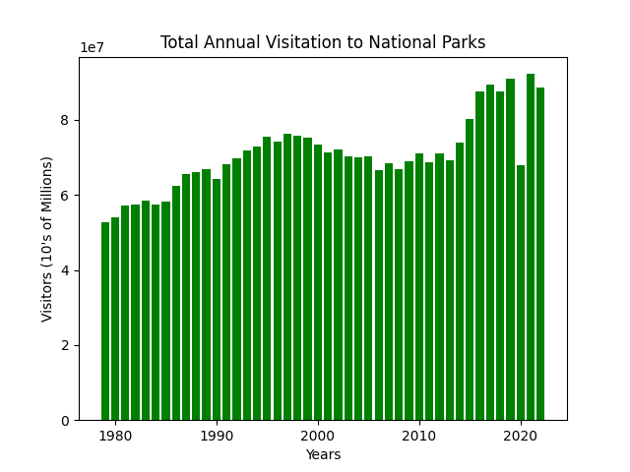
Annual Visitation
^{Steady until 2015}
Large increase in the last 5-10 years
^{2020 outlier year}

Slide 4
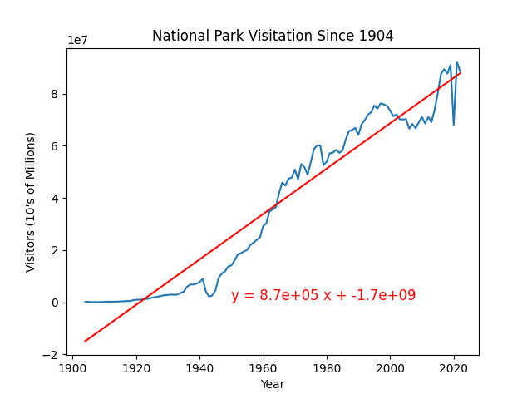
Visitation trends
870,000 new visitors annually
Strong upward correlation
Is it sustainable?

Slide 5
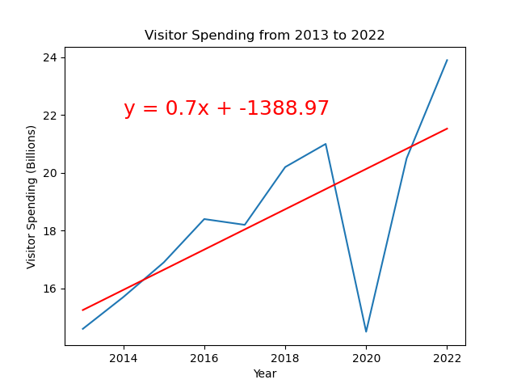
Annual Funding From Visitations
Average increase $700 million every year
Slight decrease in 2017
Significant decrease in 2020
What could be the reason?

Slide 6
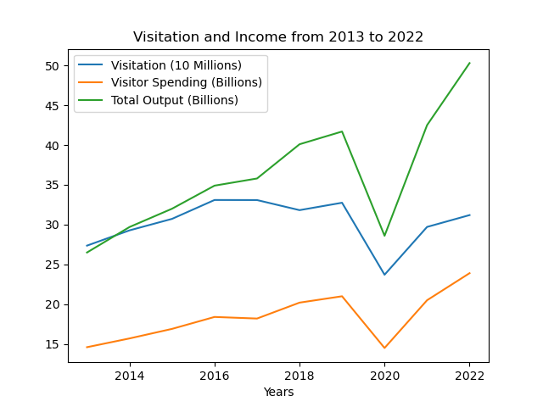
Economic Output
Visitation and visitor Spending are similar
Large dip in 2020
Significant increase economic output 2022

Slide 7
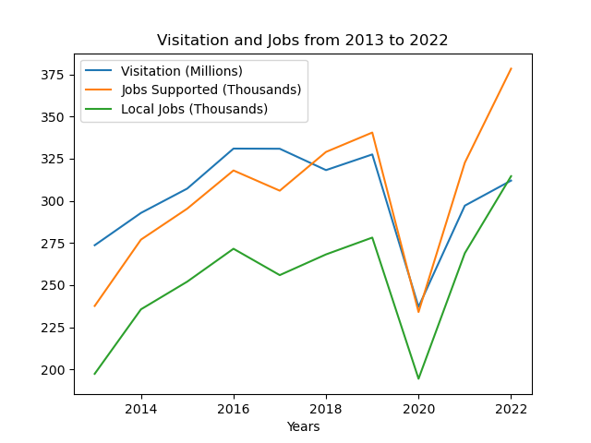
Job Trends
More visitation requires more upkeep
Slight decrease of jobs 2017
Large increase of jobs after 2021

Slide 8
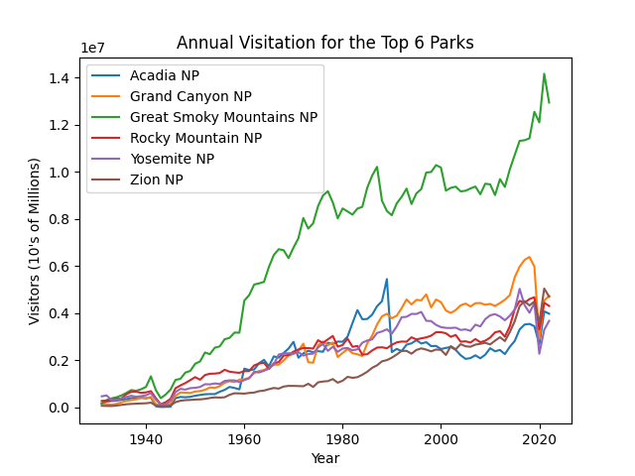
Top 6 Parks
Consistent growth
1989 dip?
Great Smoky mountains very popular

Slide 9
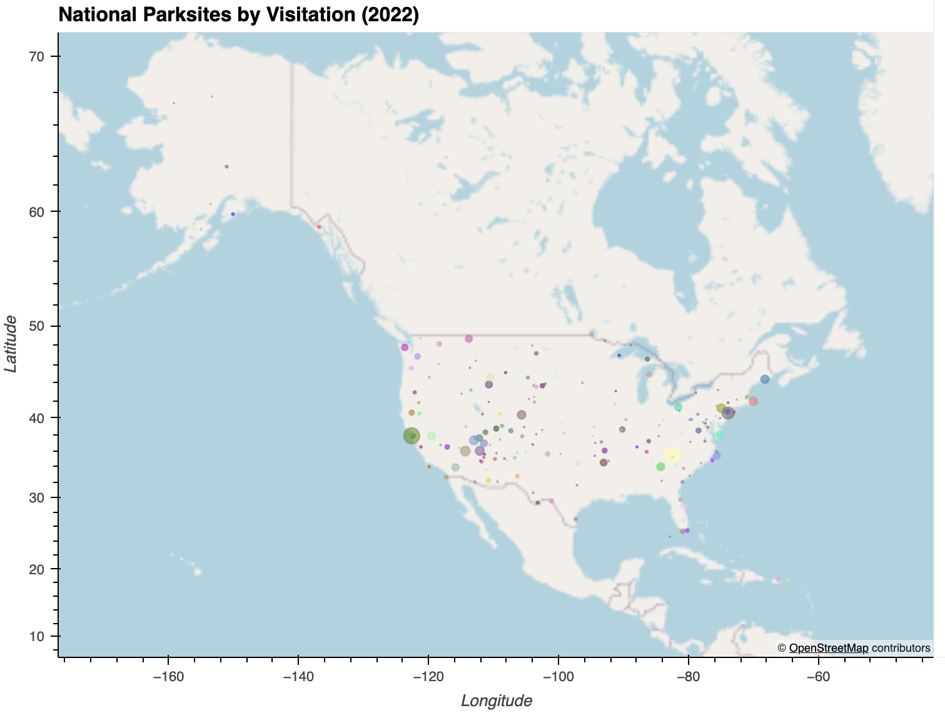
All National Park Sites
Less visitation in Alaska and Hawaii
More park locations and visitors in contiguous US

Slide 10
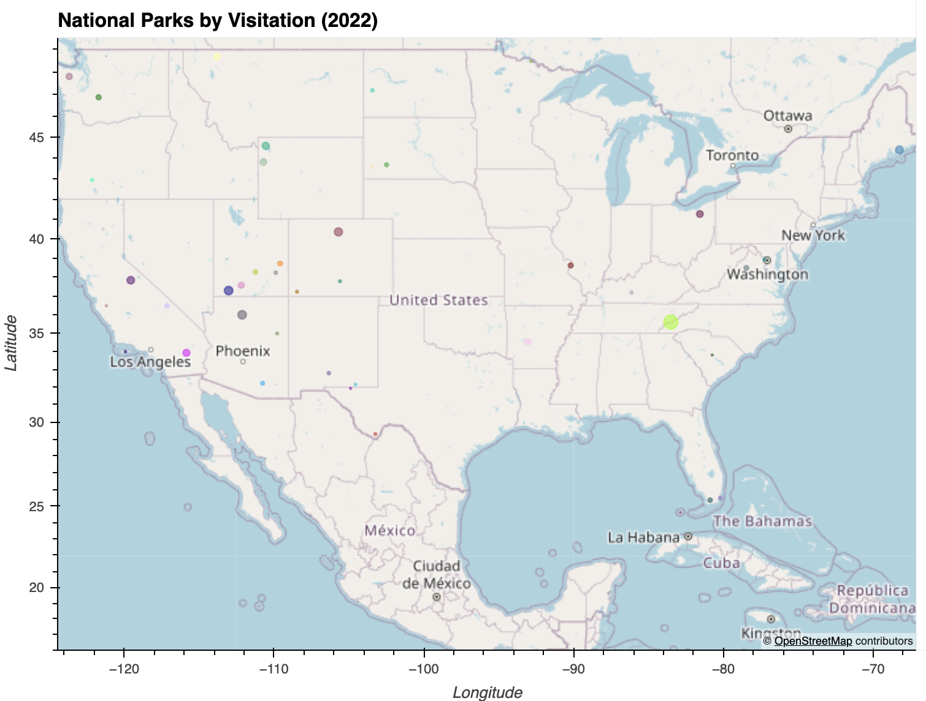
National Parks in Contiguous US
More national parks and visitation in the west
Most visited national park in NC and TN

Slide 11
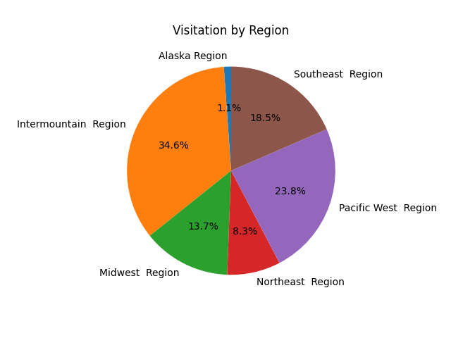
Visits by region
Distribution consistent with map
Less presence on the east coast

Slide 12
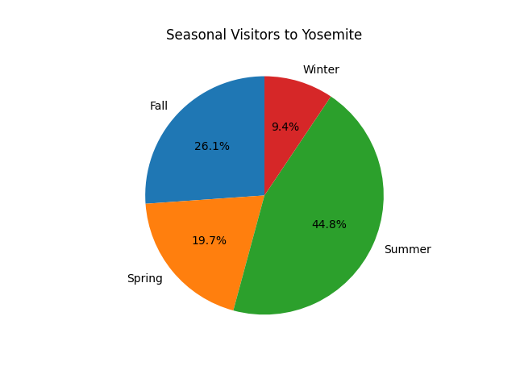
Seasonal Variance
Summer is the most popular time
Winter = low crowds, potential bad weather

Slide 13
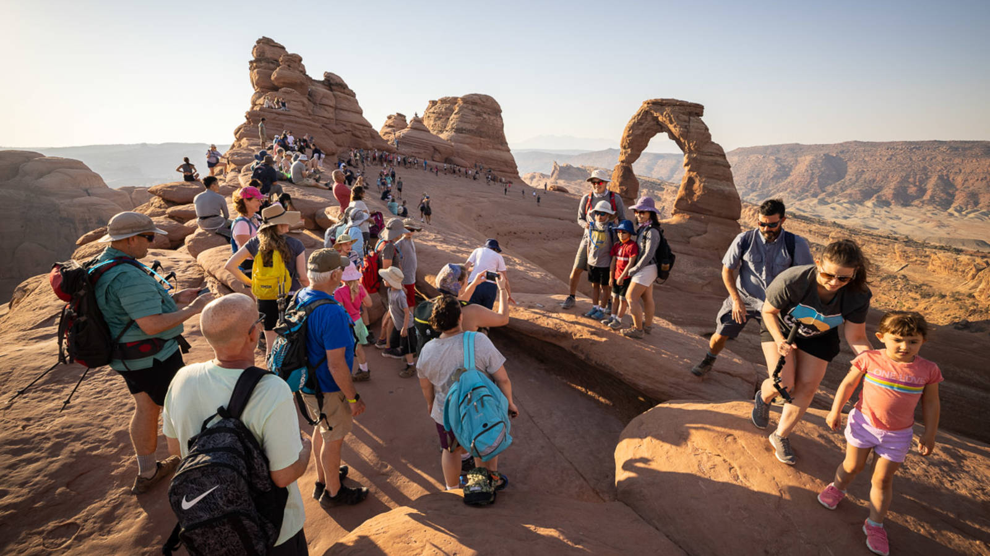
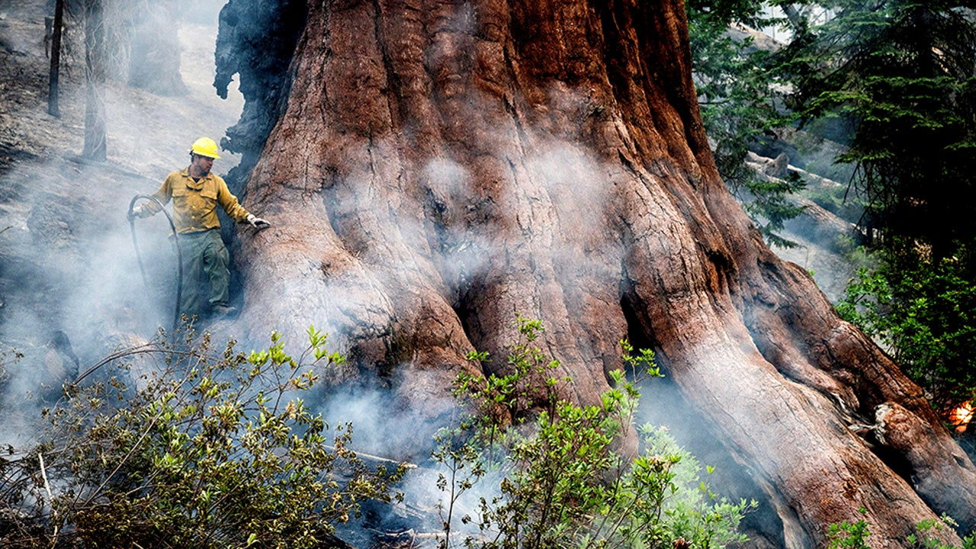
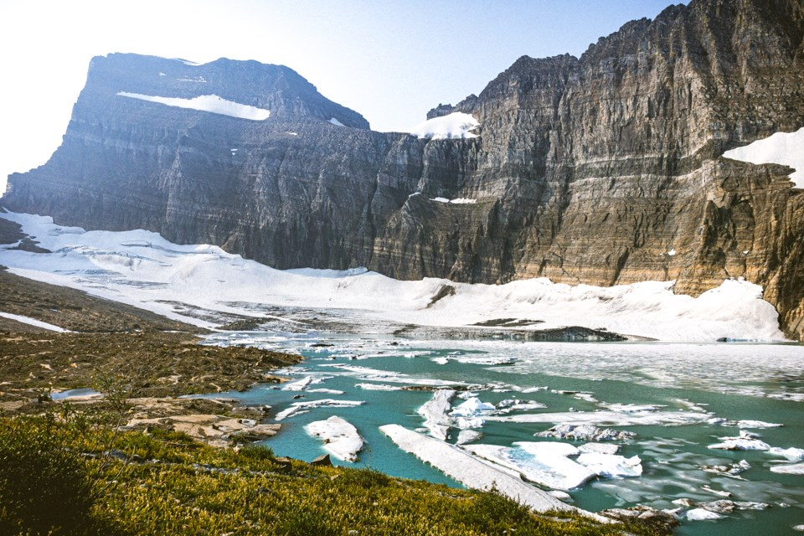
Where to go next
Looking at infrastructure/personnel Investments to support growing demand.
What can be done to make the increase in visitation sustainable. Crowd problems.
Comparing Acreage to visitation. Is there more Land for all of these people to appreciate nature?
How will Climate change affect the future of the parks?
What can be applied to protecting land across the world.

